Slide 1

AI-Powered Handwritten Answer Sheet Evaluation System
by
R.LIKHITHA
Roll No. 224G1A0541
M.SUNITHA
Roll No. 224G1A05B0
P.PRATHIBHA
Roll No. 224G1A0575
Under the guidance of
Mr. C. Sudheer Kumar, M.Tech, (Ph.D)
Assistant Professor
Designa
Department of Computer Science and Engineering
Srinivasa Ramanujan Institute of Technology
Autonomous
Rotarypuram Village, B K Samudram Mandal, Ananthapuramu – 515701.
Accredited by NBA & NAAC with “A” Grade,Affiliated to JNTUA,Ananthapuramu
2025-2026

Slide 2
Review 0 Queries
What is the difference between the existing college evaluation system and our project?
Have you referred to any research papers for this project?

Slide 3
Title Explaination
The AI-Powered Handwritten Answer Sheet Evaluation System uses Artificial Intelligence to automatically evaluate handwritten student answers.
Handwritten answers are converted into digital text using OCR, and AI compares them with model answers to assign marks based on accuracy and relevance. This system reduces teachers’ manual work and provides faster, fair, and consistent evaluation.
It is useful for educational institutions to automate exam evaluation while maintaining quality.
The main goal of this project is to:
Reduce manual effort of teachers
Ensure faster, fair, and unbiased evaluation
Improve consistency and accuracy in answer sheet assessment

Slide 4
Contents
Abstract
Introduction
Software Requirements
Datasets/Modules
Implementation
Outputs
Conclusion
References

Slide 5
Abstract
Introduction: Manual evaluation of handwritten answer sheets is time-consuming and may lead to inconsistency and human error.
Research Gap: Existing systems focus on digital or keyword-based evaluation and lack accurate assessment of handwritten descriptive answers.
Methodology Used: Handwritten answers are scanned, converted to text using OCR, and evaluated using AI techniques by comparing them with model answers.
Result: The system provides faster evaluation with improved accuracy and consistent marking compared to manual correction.
Conclusion: The proposed system reduces teacher workload and enables fair, automated answer sheet evaluation for educational institutions.

Slide 6
Introduction
The AI-Powered Handwritten Answer Sheet Evaluation System is designed to automatically evaluate handwritten student answers using Artificial Intelligence, reducing the need for manual correction.
Manual evaluation of answer sheets is time-consuming, requires a lot of effort from teachers, and may result in inconsistent or biased marking.
With the increasing number of students and exams, there is a strong need for an automated, accurate, and fair evaluation system that can handle handwritten answers efficiently.
The project aims to improve evaluation speed, accuracy, and consistency while reducing the workload on educators.

Slide 7
Software Requirements
Programming Languages: Python, HTML, CSS, JavaScript
AI ML Libraries: Scikit-learn (for model development)
OCR Tool: Tesseract OCR (for handwritten text recognition)
Web Framework: Flask (for application development)
Database: SQLite (for storing student data and results)
Development Tools: VS Code, Jupyter Notebook
Operating System: Windows

Slide 8
Datasets/Modules
Consists of handwritten student answer sheets uploaded in PDF format.
PDFs contain scanned pages of descriptive handwritten answers.
Includes multiple handwriting styles and variations in writing quality.
Model answers provided by faculty are used as reference data.
PDF files are converted into images/text during preprocessing for OCR.
Dataset is used for text extraction and AI-based answer evaluation

Slide 9
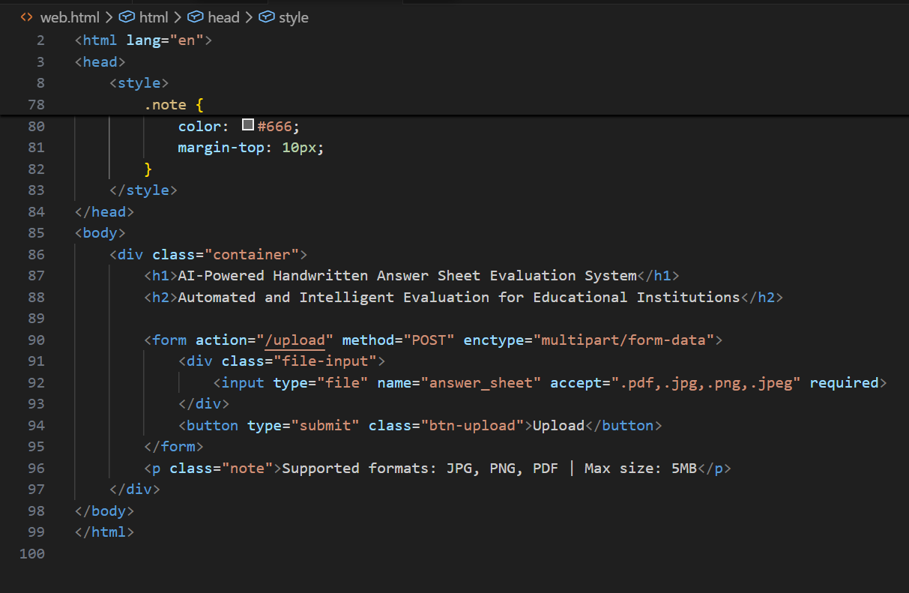
Implementation

Slide 10
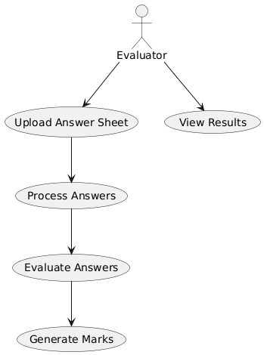
Implementation
Use Case Diagram:

Slide 11
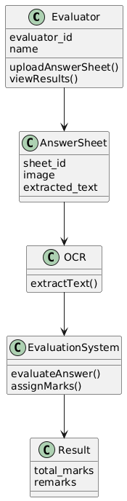
Implementation
Class Diagram:

Slide 12
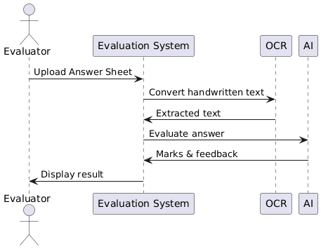
Implementation
Sequence Diagram:

Slide 13
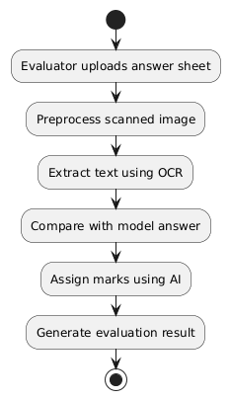
Implementation
Activity Diagram:

Slide 14
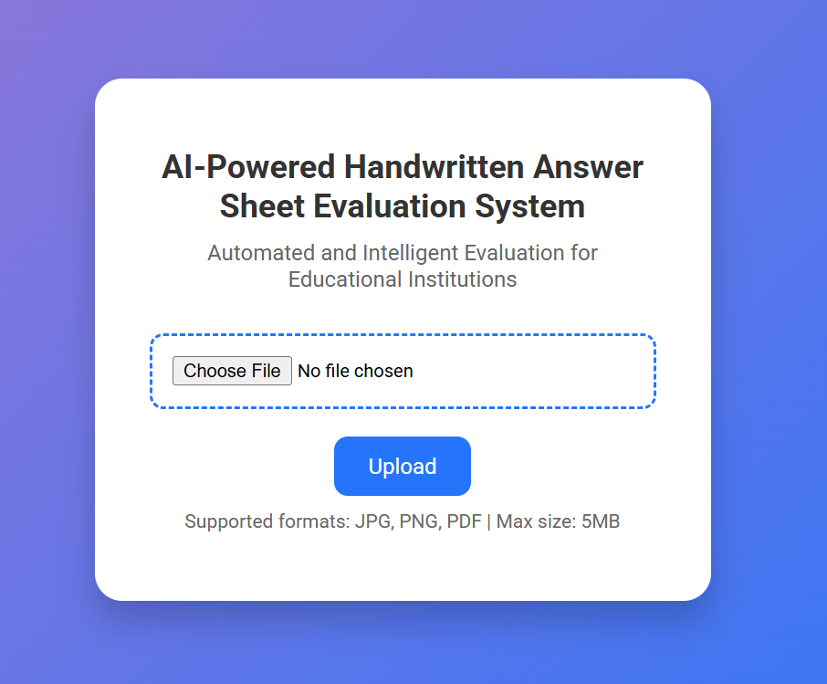
Outputs

Slide 15
Conclusion
The project successfully automates the evaluation of handwritten answer sheets using AI and OCR technologies.
It reduces manual effort of teachers and ensures faster and consistent answer evaluation.
The system improves accuracy and fairness in marking descriptive answers.
In the future, the system can be enhanced to support multiple languages and subjects.
Advanced AI models and cloud deployment can be added to handle large-scale examinations.

Slide 16
References
Book
[1] J. D. Kelleher, Deep Learning. 2nd ed., Cambridge: MIT Press, 2024.
Journal Article
[2] A. Hiremath, N. Irabatti, A. Desai, P. Dhondge, and S. Sheikh, “Transforming handwritten answer assessment: A multi-modal approach combining text detection, handwriting recognition, and language models,” Journal of Emerging Technologies and Innovative Research, vol. 11, no. 6, pp. 1–12, June 2024.
Newspaper article
[3] K. D. Smith, “AI reshapes student evaluations and assessments,” The New York Times, vol. 175, pp. A1, A10, Nov. 20, 2025.
Technical Report
[4] R. M. Byalal, H. P. D. Urs, K. M. Ankumaar, K. K. Nayak, and S. Sheshagiri, “AI-Driven Automated Answer Script Evaluation System: A Literature Review,” Int. J. Sci. Inno. Eng., Technical Report, vol. 2, no. 11, pp. 1198–1201, Nov. 2025.

Slide 17
Thank You

Slide 18
Any Queries

